Slide 1

Data encryption and transfer using DMS and DSP
TEAM - 11

Slide 2

TeAM MEMBERS :
SHYAM [21149]
SIDESH [21150]
SABARINATH[21141]
SASANK [21160]
BHARADWAJ[21165]

Slide 3

INTRODUCTION
The daily demands of 60 percent of the world's population include the internet, which is a need in modern living. Data security and privacy are issues when using the internet because hackers can use this data.
We proposed the advance custom configurable algorithm for AES in this project.
Digital encryption plays a crucial role in today's digital environment in protecting electronic data transfers which then processed by DSP.
No significant AES attacks have been identified so far.

Slide 4

OBJECTIVE
To encrypt the data using the custom AES which is an opensource adaptable, strong and secure encryption technique which can stop numerous threats and is extremely reliable to ensure safe data transfer, this can further be extended into message signal transferring via applying Digital Modulation Techniques which ensures unreadable and secured data transfer via signal.

Slide 5

Advanced Encryption Standard (AES)
Advanced Encryption Standard (AES) is a specification for the encryption of electronic data established by the U.S National Institute of Standards and Technology (NIST) in 2001. AES is widely used today as it is a much stronger than DES and triple DES despite being harder to implement.
Data Encryption Standard (DES)
The Data Encryption Standard (DES) is a symmetric-key block cipher published by the National Institute of Standards and Technology (NIST).
DES is an implementation of a Feistel Cipher. It uses 16 round Feistel structure. The block size is 64-bit. Though, key length is 64-bit, DES has an effective key length of 56 bits, since 8 of the 64 bits of the key are not used by the encryption algorithm (function as check bits only).

Slide 6
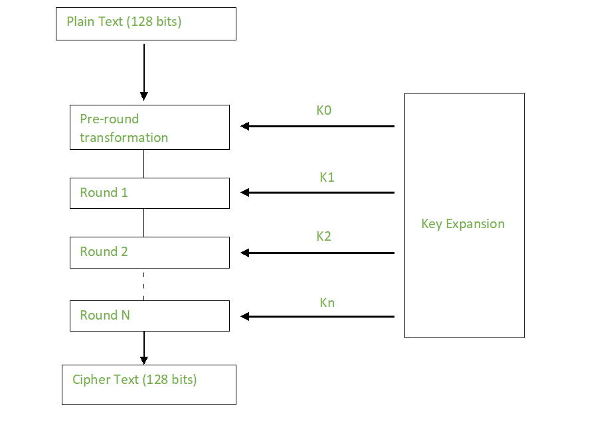
METHODOLOGY :

Slide 7
Advantages of signal encryption application
End-to-end encryption has some obvious advantages over "cleartext" (when messages or data are sent without any encryption at all) and encryption-in-transit. It's protected every step of the way, for one example.
When an app uses encryption-in-transit, that means the service you're using owns the key to encrypt and decrypt the message at the server. That provides a point of vulnerability and a vector for hackers or malicious actors to intercept your information before it travels to its destination.

Slide 8
Advantages of signal encryption application
Signal encryption isn't the perfect solution to every kind of communication need. If an app's communication is fully encrypted, that can prevent the app from offering additional features like contextual services based on the content of the message, or the ability to automatically generate calendar invites, message history, and other additional features. Simply put, the data is a black box to everyone except the sender and receiver, which might not always be desirable.
The security that end-to-end privacy offers might be limited if a third party gets physical access to the device at either end of the transmission — not only can they read existing messages, but also send new ones. That's why it's critical to use passwords, passcodes or biometrics to protect access to your device.
While end-to-end encryption can prevent anyone (including, in general, the government and law enforcement) from reading the content of your messages, it doesn't hide or encrypt the metadata. That means it's possible to determine who you sent messages to, and when, even if the content is encrypted.

Slide 9




THANK YOU

